Slide 1
Spark Eco System

Slide 2
Spark Eco System
Spark SQL
Spark Streaming
Mlib (Machine Learning)
GraphX
SparkR

Slide 3
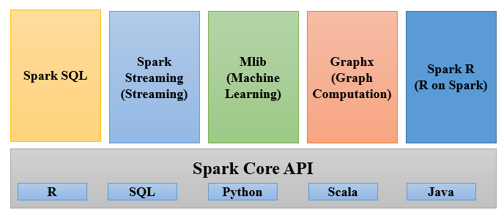
Spark Eco System
Spark Core(RDD):
Fundamental data structure of Spark.
RDD (Resilient Distributed Dataset), fault-tolerant collection of elements that can be operated on in parallel.
Spark SQL:
Running SQL like queries on Spark data.

Slide 4
Spark Eco System
Spark Streaming:
Scalable, fault-tolerant, high stream processing of live data streams.
MLib:
Scalable practical machine learning.
Graphx:
Graphs and graph-parallel computation.
SparkR:
R package that provides a light-weight frontend to use Apache Spark from R.

Slide 5
Questions
Notes:
Application Delivery Fundamentals (ADF) 2.0: Testing
Module 02: Introduction to Software Development Life Cycle (SDLC)

Slide 6
Thank You

